Slide 1

Examining the Returns to Public Investment in Science
KID summer school 2017
Michele Pezzoni

Slide 2
Outline
Introduction
Three open questions in literature
2 papers

Slide 3
What is a competitive research grant?
A funding agency establishes a budget available to be spent in a particular kind of research
Researchers apply for this money by writing and submitting research proposals
The agency solicits experts in the field to evaluate the proposals
A committee or ‘panel’ organized by the agency meets, reviews the proposals and the external referee reports, and ranks (or grades) the proposals in terms of priority for funding
The Agency decides which proposals to fund, and how much money to award to each applicant
Source: Jaffe 2002
Notes:
We will focus on the competitive research grants as a mean to fund researchers

Slide 4
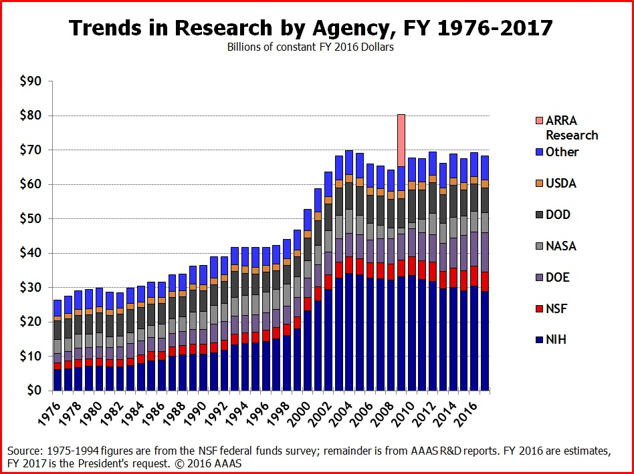
Why should we study competitive research grants?
Notes:
-budget available to funding agencies that fund research with competitive grants
-size of the investment
-growing trend

Slide 5
Are the research funding policy decisions coherent?
In response to the severe economic crisis started in 2008, the Obama’s administration launched the fiscal stimulus known as the American Recovery and Reinvestment Act [+$10.4 billion to NIH]
Trump’s administration decided on double-digit cuts for the Environmental Protection Agency (EPA) and the National Institutes of Health (NIH) [-18%].
In 2010, the French government launched the "Initiative d'excellence" (IDEX) [+7 billions]
Notes:
-the big investments relies on the assumption that funding science is good (bad in case of trump)
-goverments often decide to increase the investment in science in response to economic crises

Slide 6
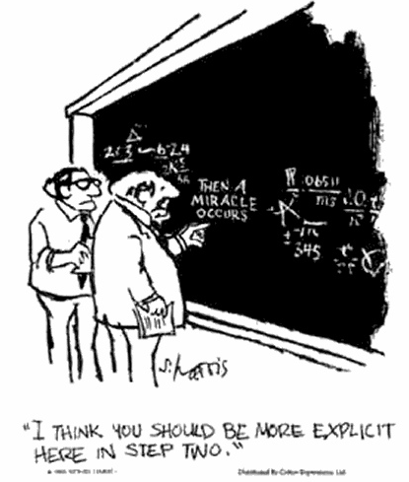
Is it fruitful to invest in science?
Need to have correct estimations of the investment returns in terms of
  Scientific knowledge creation
  Economic growth
  Job creation
Source: Lane, 2009
Notes:
-Is it enough? Too much? Too little?

Slide 7
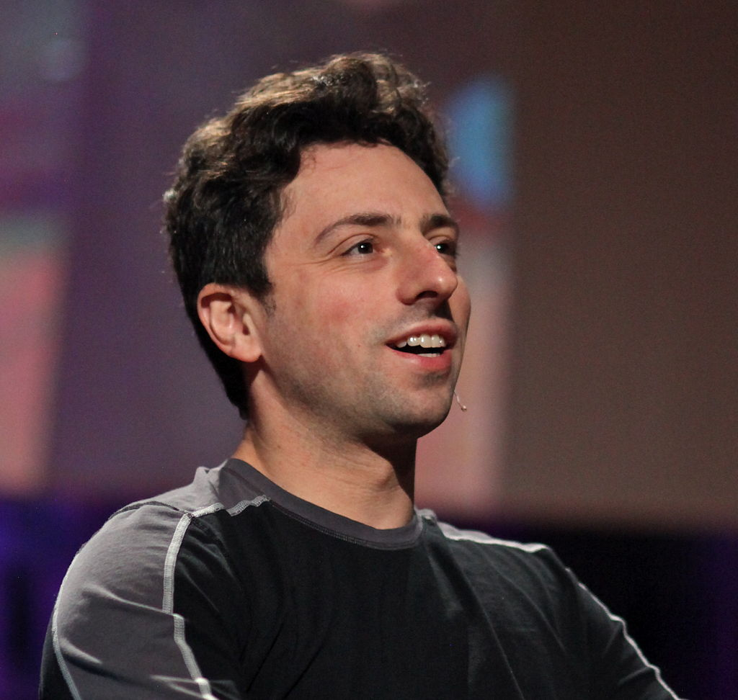
Is it fruitful to invest in science?
Existing estimations:
  Reports -> The Information Technology and Innovation Foundation estimates that +20 billion in research leads to the creation of 402.000 American jobs
  Practitioners’ comments -> Jeremy Berg, Director of NIGMS at NIH
  Anecdotal evidence -> Sergey Brin, one of the founder of Google, partly supported by NSF
  A growing research field of science of science and innovation policy (SciSIP)

Slide 8
SciSIP Literature empirical results
Focus of the literature on the impact of being awarded a grant and its amount
Article | Data source | Results
Azoulay et al. (2015) | National Institutes of Health (NIH), awarded grant applications in pharmaceutical and biotechnology | +2.3 patents every 10 million $
Gush et al. (2015) | New Zealand Marsden Fund, awarded and not awarded | +3-5% publications; +5-8% in citation-weighted papers
Jacob and Lefgren (2011) | NIH applications, awarded and not awarded | +7% publications
Arora and Gambardella (2005) | NSF applications in economics, awarded and not awarded | Modest positive impact limited to young applicants
Carayol and Lanoe (wp 2017) | ANR, awarded and not awarded applicants | +3% publications
Notes:
Modest impact of being awarded a grant

Slide 9
Main methodological challenge
Researcher productivity
Dummy identifying individuals who are awarded a grant
Observable determinants (age, gender, etc.)
Unobservable determinants at individual level (ability)
Time effects (overall positive publication trend)
Time variant unobservable determinants
(quality of the research proposal observed only by the funding agency)
The selection bias problem
D might be correlated with α and ω
  -> the projects (and scientists) that are the best candidates for funding are also the projects that would have the largest expected output in the absence of funding
Source: Jaffe 2002

Slide 10
Possible solutions
Regression with controls.
  Arora and Gambardella (2005) control for the unobserved α by including in the regression the researchers’ productivity before the application
Matched samples of treated and untreated entities (Propensity Score Matching).
  Construct a control sample of untreated individuals that resemble as closely as possible the treated individuals (Carayol and Lanoe, 2017)
Fixed effects or diff-in-diffs or RDD
  The unobserved α and the common time trends μ can be eliminated
Source: Jaffe 2002

Slide 11
Possible solutions: Diff-in-diffs strategy
Productivity
(publications)
Awarded average productivity
Effect of being awarded
Common trend
Not awarded average productivity
Common trend
Application
Year (t)
Time
Pre
Post
The identifying assumption is that productivity trends would be the same in the absence of treatment
Notes:
the dots represent the actual average in the two periods.
The identifying assumption is that productivity trends would be the same in the absence of treatment.
Treatment induces a deviation from this common trend.
Although the awarded and not awarded can differ, this difference is captured by the awarded dummy.

Slide 12
Possible solutions
Instrumental variables. Find an instrument that affects the probability of selection but does not affect performance
  Azoulay et al. (2015) use as instrument the aggregate fund availability in specific research areas
Source: Jaffe 2002

Slide 13
Pros and Cons of the extant studies
Pros
  Large samples (all the NIH/NSF/ANR applications)
  Detailed data at individual level (Age, gender, academic rank, institution)
  Well coverage of bibliometric data over time and disciplines
Cons
  Limited availability of the information internal to the funding agency (grade and ranking of the application)
  The analysis usually focuses on a single grant but researchers have other sources of funds
  Not all the productivity of the researchers can be attributed to one single grant

Slide 14
What is a competitive research grant?
Lack of studies
A funding agency establishes a budget available to be spent in a particular kind of research
Researchers apply for this money by writing and submitting research proposals
The agency solicits experts in the field to evaluate the proposals
A committee or ‘panel’ organized by the agency meets, reviews the proposals and the external referee reports, and ranks (or grades) the proposals in terms of priority for funding
The Agency decides which proposals to fund, and how much money to award to each applicant
Focus of the extant literature
Source: Jaffe 2002
Notes:
In order to understand better the last point of the previous slides

Slide 15
Motivation for studying the application phase
The scientific community is debating about the utility of spending energy and time in applying for grants where there are few chances to get awarded
NSF 23%
NIH 15%
H2020 14%
FP7 13%
Sources: ec.europa.eu; www.nsf.gov; report.nih.gov
Notes:
Application success rates:
NSF 23%
NIH 15%
H2020 14%
FP7 13%

Slide 16

Negative aspects of applying to a grant
“Grant applications divert scientists from spending time doing science … [a] chemist in the U.S. can easily spend 300 hours per year writing proposals” (Stephan, 1996)
Notes:
Application success rates:
NSF 23%
NIH 15%
H2020 14%
FP7 13%

Slide 17

Negative aspects of applying to a grant
“The research funding system is broken: researchers don’t have time for science anymore. […] they are judged on the amount of money they bring to their institutions” (Ioannidis, 2011)

Slide 18
Positive aspects of applying to a grant
More and more grants require collaboration among researchers
Applying might allow for
  Knowledge exchange and learning between co-applicant researchers (Ayoubi et al. 2017)
  Generation and formalization of new appealing research ideas
  Establishing collaborations among co-applicants (Etzkowitz, 2003)

Slide 19





Funding agencies
Rising attention of national funding agencies for efficient funds allocation
  “My job as director of NIGMS is to work to maximize the scientific returns on the taxpayers’ investments” (Lorsch, 2015)
Notes:
mainly driven by the growing desire of governments to control public money spending

Slide 20

Funding agencies
Funding agencies such as ERC, NIH, NSF, Wellcome Trust, would like to know the degree to which research can be attributed to their funds
In 2010 a post by Jeremy Berg on his blog, Director at the time of NIGMS at NIH, took a step at answering the question

Slide 21
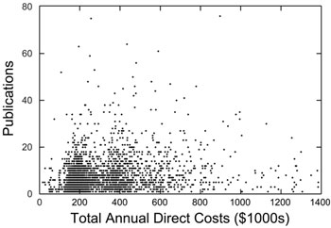
Jeremy Berg analysis
Related amount of funding NIGMS investigators received in fiscal year 2006 to number of articles published during period 2007-2010.
Correlation coefficient of .14 between amount and number of publications

Slide 22
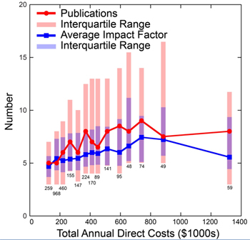
Jeremy Berg analysis
Analysis also suggested that diminishing publication productivity set in around $600,000 to $750,000

Slide 23
Summing up:
3 open research questions
  1. Is the application process only costly for scientists?
  2. Does being awarded a grant have an impact on the subsequent researcher’s productivity?
  3. What are the returns of 1$ of public money awarded to a researcher by a funding agency?

Slide 24
2 papers
The important thing is not to win but to participate:
The case of a competitive grant race benefiting scientists without awarding them (Ayoubi et al. 2017)
    1. Is the application process only costly for scientists?
    2. Does being awarded have an impact on the subsequent scientist’s productivity?
  Examining the Returns to Investment in Science: A Case Study (Lane et al. 2017)
    3. What are the returns of one dollar of public money awarded to a researcher by a funding agency?

Slide 25
2 papers
The important thing is not to win but to participate:
The case of a competitive grant race benefiting scientists without awarding them (Ayoubi et al. 2017)
    1. Is the application process only costly for scientists?
    2. Does being awarded have an impact on the subsequent scientist’s productivity?
  Examining the Returns to Investment in Science: A Case Study (Lane et al. 2017)
    3. What are the returns of 1$ of public money awarded to a researcher by a funding agency?

Slide 26
Examining the Returns to
Investment in Science:
A Case Study
Julia Lane¹, Jacques Mairesse²,
Michele Pezzoni³, and Paula Stephan⁴
¹ Wagner School, New York University, New York, New York, United States of America, University of Strasbourg, Strasbourg, France, University of Melbourne, Melbourne, Australia
² CREST-ENSAE, Paris, France; UNU-MERIT, Maastricht University, Netherlands; and NBER, Cambridge, Massachusetts, United States of America
³ GREDEG, Nice University, Nice, France; ICRIOS, Bocconi University, Milan, Italy; BRICK, Collegio Carlo Alberto
⁴ Andrew Young School, Georgia State University, Atlanta, Georgia, and NBER, Cambridge Massachusetts, United States of America

Slide 27
Fundamental question for a funding agency
  What are the returns of 1$ of public money awarded to a researcher?
  Researchers have often more than one source of funding
  How is the focal grant output affected by the presence of other sources of funding?

Slide 28
Bundling effect
Principal Investigator (PI) level
The funding agency has a budget of 200000$ and needs to chose between two applications
  Application 1: a talented instigator with a fund endowment of 400000$
  Application 2: a promising new investigator with no other funding (from 0$)
Source: Lorsch, 2015

Slide 29
Focal grant funds VS focal grant output
We expect a positive relationship between the funds from focal grant and its output
  More PI’s time devoted to the focal grant (+)
  More time of PhDs, research assistants, and postdoctoral fellows devoted to the focal grant (+)
  Access to materials and equipment (+)

Slide 30
Other sources of funds VS focal grant output
Other sources of funds might influence the productivity of the focal grant
  providing more resources that can be shared across research projects (+)
  taking time away from the focal grant (-)
  increasing the administrative tasks such as the submission of progress reports (-)
  the marginal effect of additional funds may be decreasing (-)

Slide 31
Paper contribution
Grant level analysis
Address attribution of the researcher's scientific outcome to grant yearly flow of funds
Complete coverage of the researcher public fund endowment and study of the bundling effect
Address the endogeneity issue affecting funding and productivity with the use of appropriate instruments

Slide 32
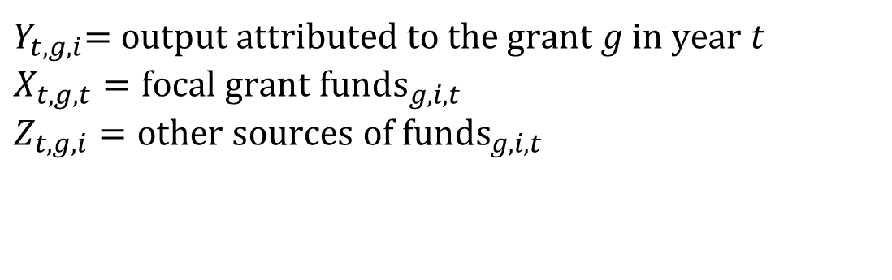
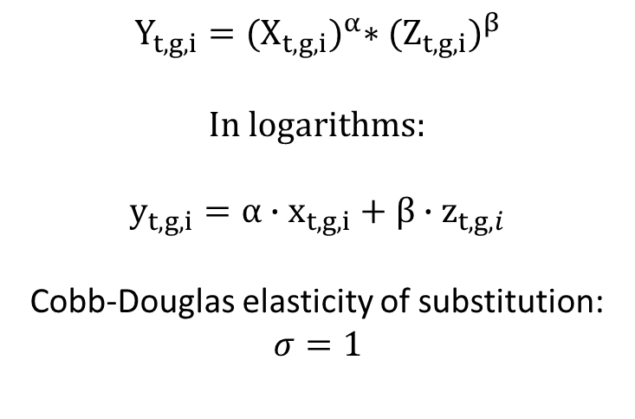
Model
$Y_{t,g,i}$= $output attributed to the grant g in year t$
$$X_{t,g,t}={focal grant funds}_{g,i,t}$$
$$Z_{t,g,i}={other sources of funds}_{g,i,t}$$
$$Y_{t,g,i}={(X_{t,g,i})}^{α}∗{(Z_{t,g,i})}^{β}$$
In logarithms:
$$y_{t,g,i}=α∙x_{t,g,i}+β∙z_{t,g,i}$$
Cobb-Douglas elasticity of substitution:
$$σ=1$$
Notes:
Ve assume a cobb-douglas functional

Slide 33
A Case Study: An Elite US University
Grant payroll
  Public Grant
  PI-Faculty
  Employees paid:
    PhDs
    PostDocs
    Staff Scientists / Technicians
Web of Science (Thomson Reuters)
  Publication data

Slide 34
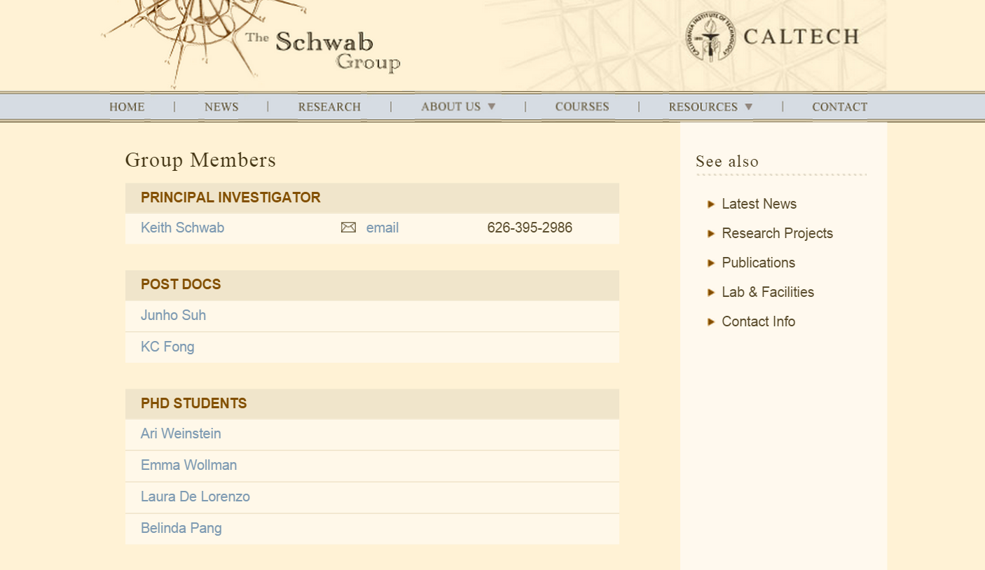


Typical lab structure in nanotechnology

Slide 35
A Case Study: An Elite US University
1544 Grants,
awarded to 240 PI-Faculty,
observed between 2000 and 2010
 | Mean | sd | min | Max | N
Grant length (years) | 4.14 | 1.47 | 1.00 | 11.00 | 1544
Awarded amount (M$) | 0.44 | 0.45 | 0.01 | 2.00 | 1544
NSF grant | 0.23 | 0.42 | 0.00 | 1.00 | 1544
NIH grant | 0.33 | 0.47 | 0.00 | 1.00 | 1544
DOE grant | 0.34 | 0.47 | 0.00 | 1.00 | 1544
DOD grant | 0.03 | 0.17 | 0.00 | 1.00 | 1544
Other grants | 0.07 | 0.26 | 0.00 | 1.00 | 1544

Slide 36
Grant bundling:
Share of PIs with n. grants

Slide 37


Attribution of the research output of a PI to a grant
At least three “methods” in literature to realize attribution of grant output to grant funds in year t
  Acknowledgement
  Text analysis

Slide 38

Attribution of research outcomes to funding
  “Pure Chronology”

Slide 39


Attribution based on the
PI-PhD student co-authorship and payment relationships
(Example 1)
PI_{i}
Focal grant funds in t
Co-authorships in t,t+1,t+2
A1_{t}
x_{t,g1,PI}
S1
A2_{t+1}
$y_{t,g1,PI}$= 1 (A1) +1 (A2)

Slide 40
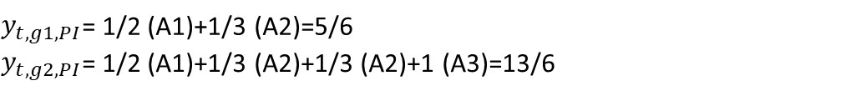
Attribution based on the PI-PhD student co-authorship
and payment relationships (Example 2)
PI_{i}
Focal grant funds in t
Co-authorships in t,t+1,t+2
A1_{t}
x_{t,g1,PI}
S1
A2_{t+1}
x_{t,g2,PI}
S2
A3_{t+1}
$y_{t,g1,PI}$= 1/2 (A1)+1/3 (A2)=5/6
$y_{t,g2,PI}$= 1/2 (A1)+1/3 (A2)+1/3 (A2)+1 (A3)=13/6

Slide 41
Study sample
3796 (PI-Grant)*year observations
We construct a three dimensional unbalanced panel grant g, PI i and year t
 | Mean | SD | min | max | N
Flow of funds
x focal grant funds [M$] | 0.11 | 0.09 | 0.01 | 0.52 | 3796
z other sources of funds [M$] | 0.38 | 0.33 | 0.00 | 2.01 | 3796
Grant Publication Productivity
Publication PI-PhD attribution | 1.52 | 2.00 | 0.417 | 24.48 | 3796
Average IF PI-PhD attribution | 1.67 | 1.47 | 0.053 | 11.56 | 3796

Slide 42

OLS estimations
$$y_{t,g,i}=α∙x_{t,g,i}+β∙z_{t,g,i}$$
 | (1) | (2)
 | OLS | OLS
 | log(Pubs) | log(avg IF)
x (focal grant flow of funds) | 0.33*** | 0.028
z (other sources of funds) | -0.15*** | -0.13***
Time dummies | yes | Yes
PI Fixed effects | yes | Yes
Observations | 3,796 | 3,796
R-squared | 0.324 | 0.506

Slide 43
IV estimation first stage
Endogeneity of the focal grant funds (x) with respect to publication productivity unobserved determinants
Dependent variables
  x focal grant funds
  z other sources of funds
Excluded instruments
  Growth of the available budget to the funding agencies at national level from t-2 to t
  A dummy variable for each funding agency that awarded the focal grant (NSF, NIH, DOE, DOD, others)
  The number of grants “active” in year t
  A dummy that equals one if there are two or more than two distinct agencies awarding the funds other than the focal grant
Notes:
See instrumental variables grant level.docx

Slide 44
  Growth of the funding agencies research budget at national level from t-2 to t

Slide 45
IV estimation
(first stage)
 | (1) | (2)
VARIABLES | x (log flow at grant level) | z (log other grants flow of funds)
growth | 0.53*** | -0.11
n. grants in year t | -0.025*** | 0.25***
NSF ref | - | -
NSF | 0.25*** | -0.026
NIH | 0.21*** | -0.093**
DOE (Dep. of Energy) | 0.61*** | -0.045
DOD (Dep. of Defense) | 0.27*** | 0.010
More than 2 agencies in the other sources of funds in t | -0.068** | 0.35***
Constant | -2.31*** | -4.54***
Observations | 3,796 | 3,796
R-squared | 0.418 | 0.811
PI Fixed Effects | yes | yes
Dummy year | yes | yes
Dummy Institution | yes | yes

Slide 46
IV estimation
 | (1) | (2)
VARIABLES | log(Pubs) | log(avg IF)
x (focal grant funds) | 0.43*** | 0.27***
z (other sources of funds) | -0.19*** | -0.20***
Observations | 3,796 | 3,796
R-squared | 0.319 | 0.475
PI Fixed Effects | yes | yes
Dummy year | yes | yes
Dummy Institution | yes | yes
Notes:
focal grant funds
z other sources of funds

Slide 47
All different estimations
Dependent var: Publications | x | z | Constant | R^2 | Obs.
OLS | 0.27 | -0.11 | 0.4 | 0.1 | 3796
OLS+PIfe | 0.33 | -0.15 | - | 0.32 | 3796
OLS+PIfe+IV(x) | 0.38 | -0.14 | - | 0.32 | 3796
OLS+PIfe+IV(xz) | 0.43 | -0.19 | - | 0.32 | 3796
OLS+IV(x) | 0.17 | -0.11 | 0.13 | 0.1 | 3796
OLS+IV(xz) | 0.34 | -0.06 | 0.72 | 0.09 | 3796
Dependent var: Average IF | x | z | Constant | R^2 | Obs.
OLS | 0.1 | -0.1 | 0.09 | 0.24 | 3796
OLS+PIfe | 0.03 | -0.13 | - | 0.51 | 3796
OLS+PIfe+IV(x) | 0.17 | -0.11 | - | 0.5 | 3796
OLS+PIfe+IV(xz) | 0.27 | -0.2 | - | 0.47 | 3796
OLS+IV(x) | 0.61 | -0.11 | 1.44 | 0.07 | 3796
OLS+IV(xz) | 0.54 | -0.13 | 1.21 | 0.11 | 3796

Slide 48

Rewriting the productivity equation: equivalent specification
$$y_{g,i,t}=α∙x_{g,i,t}+β∙z_{g,i,t}$$
$$y_{g,i,t}=\left(α+β\right)∙x_{g,i,t}+β∙{(z}_{g,i,t}−x_{g,i,t})$$
$$y_{g,i,t}=\left(α+β\right)∙x_{g,i,t}−β∙log\left(\frac{{sh}_{g,i,t}}{1−{sh}_{g,i,t}}\right)$$
where${sh}_{g,i,t}$= $x_{g,i,t}$/($x_{g,i,t}$+ $z_{g,i,t})$

Slide 49
Publication isoquants
(varying share and flow)
Notes:
The red arrow represents the isoquants’ growth. If we consider a value of log(x)=2 [74000$], the higher is the share of the grant in the PI’s portfolio, the more productive is the grant.

Slide 50
IF isoquants
(varying share and flow)

Slide 51
Bundling
We extend our findings at PI level on the basis of two simulations
A PI with two grants of different size respectively, 95%-5%, 70%-30%, 50%-50%
A PI with n. grants of equal size respectively, n=2,n=5, n=9

Slide 52
A PI with two grants of different size
Notes:
First, it assumes that it makes no difference whether a PI has four grants a year that sum to $1million or one with a direct cost of $1 million.

Slide 53
A PI with two grants of different size

Slide 54
A PI with n. grants of equal size

Slide 55
A PI with n. grants of equal size

Slide 56
Conclusion
We estimate an elasticity of 0.43: 1% increase in flow at grant level corresponds to 0.43% increase in grant publication output
Bundling matters
  Agencies have strong incentives to care about funding received by the PI from other sources since the way in which funds are bundled affects productivity of a specific grant
PI level simulations:
It is more efficient to have two grants of very unequal size for both quantity and quality of publications
When the number of grants increases, the number of publications increases -> pressure to publish
The average impact factor of publications decreases -> pressure to publish comes at the cost of quality

