Slide 1
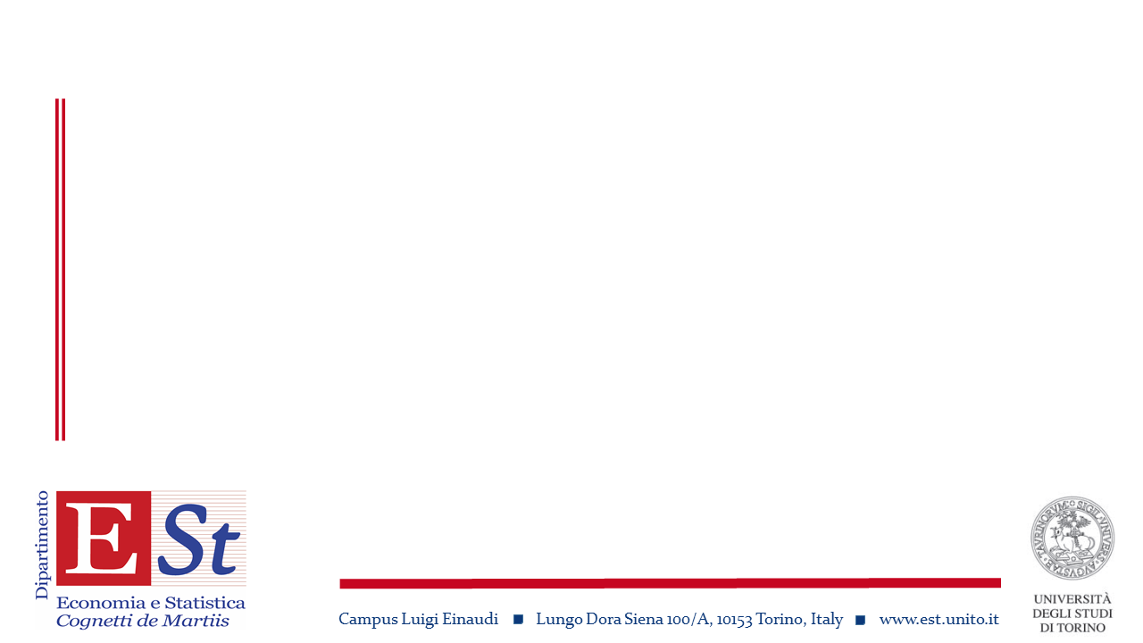
Smart specialization strategies, technological change and sustainability
Francesco Quatraro
Department of Economics and Statistics Cognetti de Martiis, University of Torino
Collegio Carlo Alberto, Torino

Slide 2
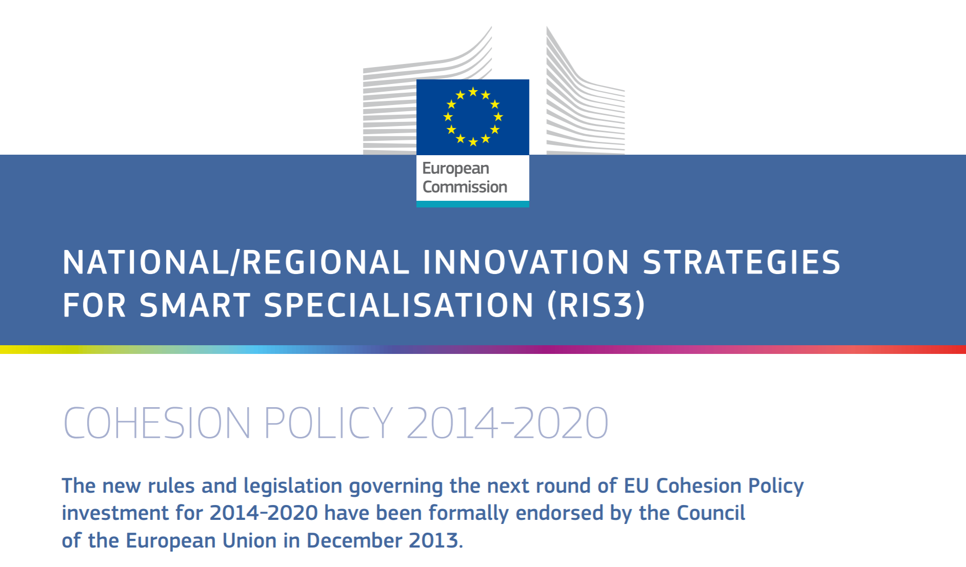
S3 Policy Background

Slide 3
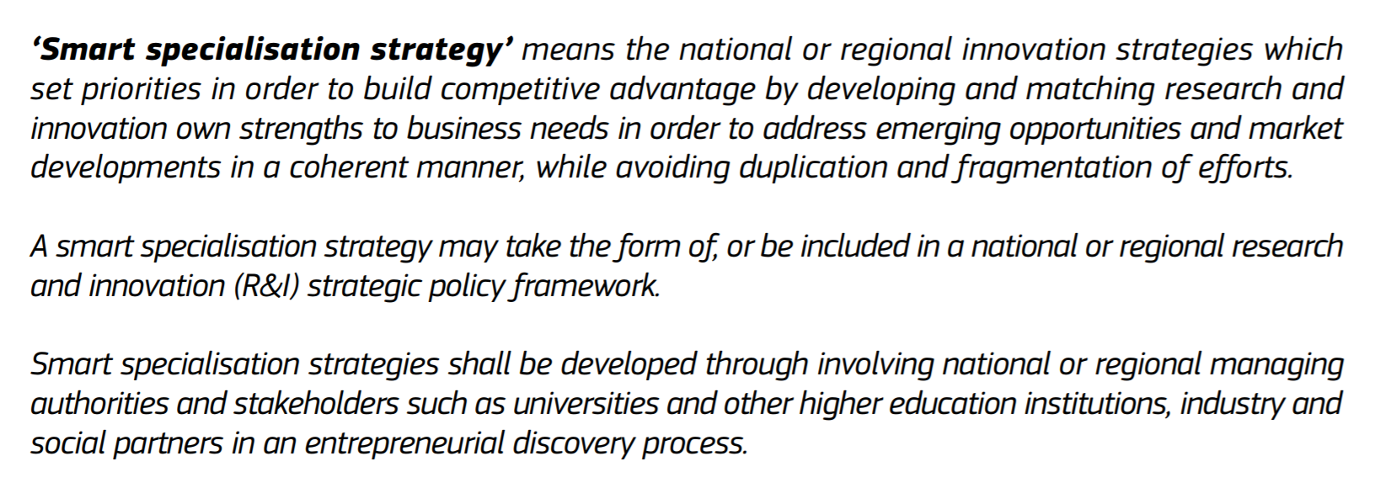
S3 Policy Background

Slide 4
S3 Policy Background
These strategies are meant to foster entrepreneurs’ ability to discover new learning opportunities for the region by drawing on previously accumulated knowledge (McCann and Ortega-Argiles (2015)
Furthermore, the EC expects S3 to spur entrepreneurial processes that prioritize GPTs, given their contribution to the general spectrum of regional technological activities and given their horizontal nature (Sörvik, Rakhmatullin, and Palazuelos Martínez 2014; Foray 2015; Pattinson et al. 2015).

Slide 5
Academic rationale
Path dependence (David, 1985) → economics of innovation, evolutionary economics
Learning dynamics (Arrow), bounded rationality (Simon), absorptive capacity (Cohen and Levinthal): firm-level dynamics
Regional branching (Frenken and Boschma 2007; Boschma and Frenken 2011): geography of innovation

Slide 6
Regional branching
The preexisting industry structure is a crucial determinant of the development path that a region embraces and the economic growth from which it can benefit
the emergence of new industries in a region can be facilitated by the presence of industries that are technologically related to them
Several cases of regional branching have been documented in different geographic contexts, especially in technological terms, by looking at the role of related (and unrelated) variety in the dynamics of scientific knowledge and technological innovations in local areas m

Slide 7
Regional branching and recombinant knowledge
the way in which relatedness spurs regional technological branching can be explained by referring to Schumpeter’s seminal insight of newly recombining existing ideas (Castaldi, Frenken and Los, 2015)
the notion of recombinant innovation defined by Weitzman (1998) and its regional declination appears crucial for the theoretical foundation of regional branching
the local variety of regions in terms of industries affects the diversity of their knowledge base and favors, per se, a cross-fertilization of ideas that generates Jacobsian spillovers (Jacobs 1969) and recombinant innovations in their boundaries.
the relatedness degree of these heterogeneous activities, expressed by the commonalities in the knowledge base that different industries can share, makes it easier to innovate by recombining ideas and technologies at the regional level.

Slide 8
What about innovation?
Innovation is the final outcome: S3 is about regional innovation strategies and the creation of new specializations
Radical or incremental? Doesn’t really matter
RIS3 deal with specializations that are new at least to the region…

Slide 9
What about innovation?
Technological change can have an ‘enabling’ role
General Purpose Technologies: horizontal (or cross-cutting) nature and complementarity between inventions and applications in their development (Foray, 2009; Bresnahan, 2010).
These two properties attribute to GPTs an important, though hitherto unrecognized, function in the technological transition that recombinant innovations drive at the regional level through branching processes (van den Bergh 2008; Frenken, Izquierdo, and Zeppini 2012)

Slide 10
GPTs and regional branching
GPTs play an important, though hitherto unrecognized, function in the technological transition that recombinant innovations drive at the regional level through branching processes (van den Bergh 2008; Frenken, Izquierdo, and Zeppini 2012)
by moving the general technological frontier of the region ahead, GPT inventions may attenuate the limits that its ruling technological paradigm previously imposed on the combinatory process of existing ideas (Olson and Frey 2002)
These are innovations of a really recombinant nature, rather than softer branching innovations occurring when the recombination takes place along a certain (and related) technological path: they’re expected to make the role of technological relatedness less binding for regional branching

Slide 11
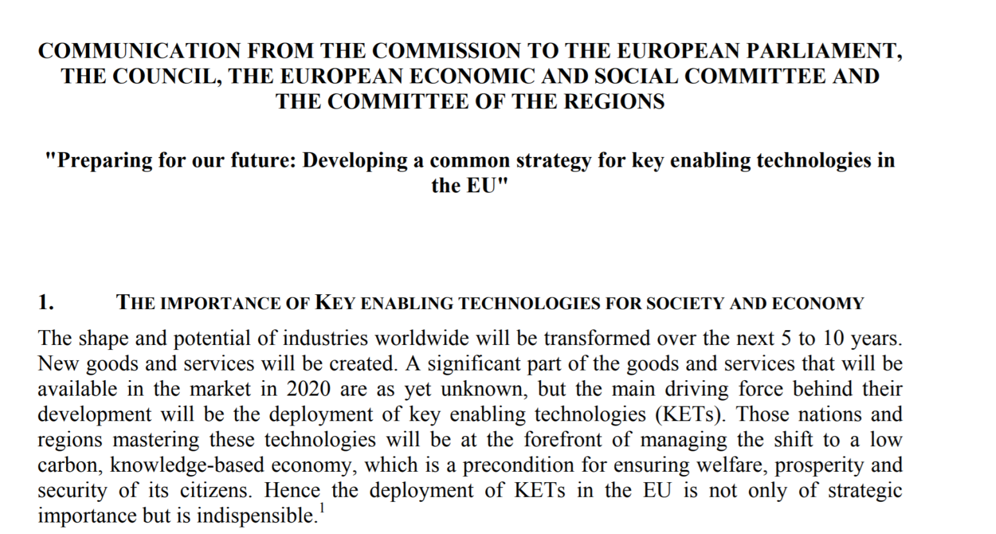
Back to policy
The importance of GPTs brings key enabling technologies (KETs) at the centre of the scene

Slide 12
Key Enabling Technologies and S3
The six KETs identified by the EC—industrial biotechnology, nanotechnology, micro- and nanoelectronics, photonics, advanced materials, and advanced manufacturing technologies—represent a new generation of GPTs acting as building blocks for a wide array of products and industrial processes in today’s economies (EC 2011).
Foray, David, and Hall (2009) point out that regions differ in their capacity to develop GPTs. In the original formulation of the concept, this fact was not deemed problematic.
a focal region does not branch its activities in isolation from other regions: Cross-regional spillovers may concern, above all, KETs, especially if we consider the explicit nature of their knowledge base

Slide 13

An empirical application
Montresor, S. and Quatraro, F. (2017). Regional Branching and Key Enabling Technologies: Evidence from European Patent Data. Economic Geography, forthcoming.
regional patent and economic data from a thirty-year panel (1980–2010) of twenty-six European countries
NUTS2 level data drawn from the Organization for Economic Cooperation and Development (OECD) Reg Pat
European Regional Database maintained by Cambridge Econometrics

Slide 14
Data
patent data were first of all used to proxy the region’s capacity to branch into new technologies by looking at its technological specializations
patent data were also used to identify the presence of KETs’ knowledge in the regions and investigate their role in regional branching
Finally, patent data were also used to measure the technological relatedness between the new and the existing technologies, and other technological determinants of regional branching

Slide 15
How to proxy regional branching?
The focal dependent variable was built by looking at region i’s acquisition of a new technological specialization s at time t
Revealed Technology Advantage:
Let New_RTA_{ist} = 1 if RTA_{ist} > 1 and 0 < RTA_{ist-k} < 1; 0, otherwise

Slide 16
How to proxy ‘smartness’?
Technological relatedness index
Different alternatives: Jaffe et al. (1989); Teece et al. (1996); Hidalgo et al. (2007).
The idea is that the higher is the number of places in which two different technological fields jointly appear as technological specializations, the higher the technological relatedness between the two.
The fact that two technological fields are frequently observed as distinctive advantages across regions may imply that they rely on similar or complementary capabilities and competences.

Slide 17
The relatedness index

Slide 18
How to proxy KETs?
Again referring to the idea of revealed technological advantage, its formula is calculated by considering regional patents in any of the KETs-mapped IPC classes (RTA_KETs_{it-1}) and in those that pertain to each KETs j of the six (RTA_KETsj_{it-1}).
In both cases, for the same reasons as discussed with respect to the dependent variable, a five-year moving average was considered.

Slide 19
A sketch of spatial distribution

Slide 20
A sketch of spatial distribution

Slide 21
Econometric strategy
The nature of the dependent variable, New_RTA_{it}, which is a count one with a nonnormal distribution, would require the implementation of count-data models in a panel setting to estimate the model
However, we should also consider that the model regresses the dependent variable at time t against its lagged value
we used GMM model by making some changes to our own dependent variable that could prevent problematic issues in its application to count data

Slide 22
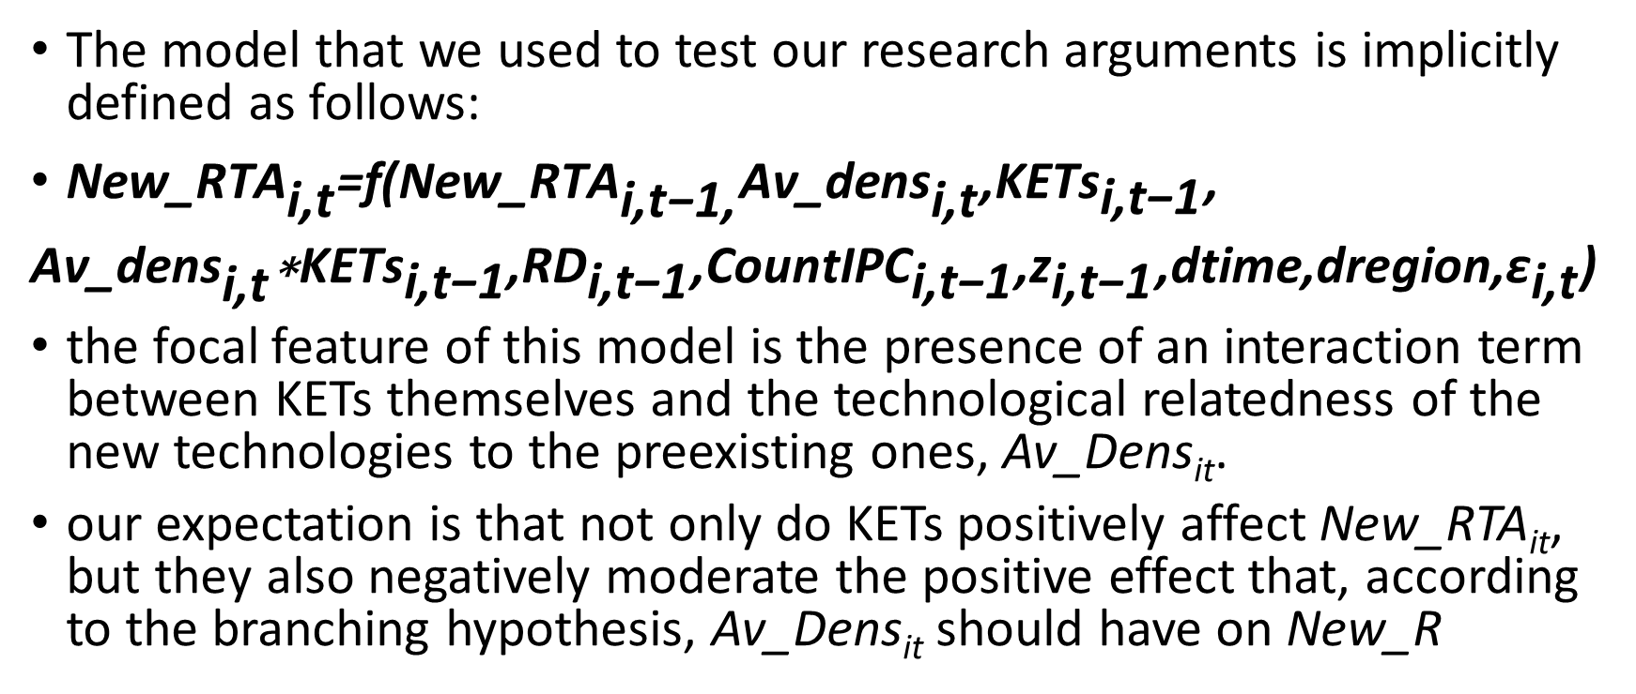
The econometric strategy
The model that we used to test our research arguments is implicitly defined as follows:
${\text{New}\text{_}\text{RTA}}_{\text{i}\text{,}\text{t}}\text{=}\text{f}\text{(}{\text{New}\text{_}\text{RTA}}_{\text{i}\text{,}\text{t}\text{−1,}}{\text{Av}\text{_}\text{dens}}_{\text{i}\text{,}\text{t}}\text{,}{\text{KETs}}_{\text{i}\text{,}\text{t}\text{−1}}\text{,}$
${\text{Av}\text{_}\text{dens}}_{\text{i}\text{,}\text{t}}\text{∗}{\text{KETs}}_{\text{i}\text{,}\text{t}\text{−1}}\text{,}{\text{RD}}_{\text{i}\text{,}\text{t}\text{−1}}\text{,}{\text{CountIPC}}_{\text{i}\text{,}\text{t}\text{−1}}\text{,}{\text{z}}_{\text{i}\text{,}\text{t}\text{−1}}\text{,}\text{dtime}\text{,}\text{dregion}\text{,}{\text{ε}}_{\text{i}\text{,}\text{t}}\text{)}$
the focal feature of this model is the presence of an interaction term between KETs themselves and the technological relatedness of the new technologies to the preexisting ones, Av_Dens_{it}.
our expectation is that not only do KETs positively affect New_RTA_{it}, but they also negatively moderate the positive effect that, according to the branching hypothesis, Av_Dens_{it} should have on New_R

Slide 23
Econometric strategy
the construction of regional technological advantages may be affected by the KETs efforts of geographically closer regions
the technological effects that KETs can exert in the regional knowledge base may extend beyond a region’s geographic boundaries
in regard to possible spatial dependence phenomena of this kind, traditional econometric models may yield biased results. Spatial econometrics should be preferred as more reliable.

Slide 24
Testing spatial autocorrelation

Slide 25
Results (I)

Slide 26
Results (II)

Slide 27
Results (III)

Slide 28
Results (IV)

Slide 29
Conclusions
the six KETs enable European regions to increase their portfolios of new technologies over time, confirming their theoretical role in providing regions with an extra buffer of branching capacity at the extensive margin
All of the six KETs also attenuate the impact that relatedness to preexisting technologies has on the acquisition of new ones, confirming the theoretical arguments about their role in a more exploratory extension of the regional knowledge base
In brief, KETs guarantee regions a higher capacity to master new technological advantages by combining with the role of regional experience and technological relatedness in the same respect

Slide 30
Future research: how about sustainability?
importance of green technologies for a sustainable kind of growth
through a proper policy-regulation and competence setting, green technologies can simultaneously contribute to coupling and decoupling growth, to new knowledge development, and from environmental degradation, respectively
at the regional level, the connection between (green-) technologies and sustainability has been recognised only recently

Slide 31
Connecting S3 and green regional branching
Building up and extending previous case studies (e.g. Cooke, 2008; 2012), some first systematic evidence of this kind of “green-branching” has been actually found with respect to European regions (van den Berge and Weterings, 2013).
While for sure important, the role of relatedness in regional eco-technological development is however only part of the story.
the literature on the knowledge sources for EIs can provide useful inputs to understand this link

Slide 32
Connecting S3 and green regional branching
complex and systemic nature of EIs, and the consequent need to access external knowledge sources for recombinant innovation processes
Rennings and Rammer (2009) and Horbach et al. (2013) have suggested that the importance of external knowledge for EIs is due to the fact that firms, with the exception of firms in eco-industries, may require knowledge and competences that are not part of their core competences.
Dechezlepretre et al. (2014): spillovers from ‘clean’ and ‘dirty’ technologies: history matters!
Importance of variety of competences at the local level

Slide 33
Thank you for your attention!

Slide 34
